Slide 1
MUM MPP Library Project
Kareem said ali
Hisham mounir

Slide 2
Project Info
It’s a library project made to add books to the library collection and adding members to the system so they can checkout books easily and let the administrators add copies of a specific book.
First, in order to access the system, the admistrator/member needs to login first.
After that, the user can access whatever functionalities he’s assigned to do.
The library member can checkout books.
The administrator can add new members, add books and copies as well.

Slide 3

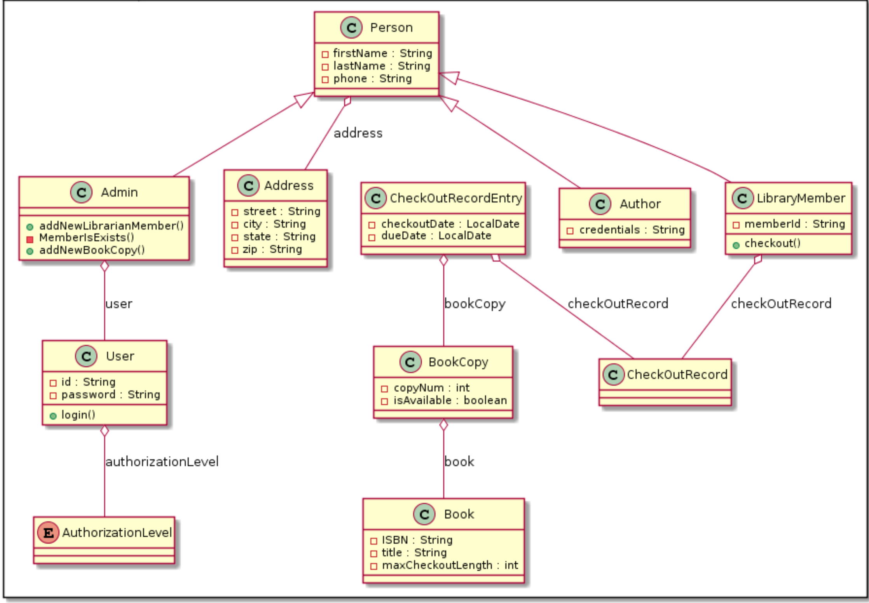



Class Diagram

Slide 4
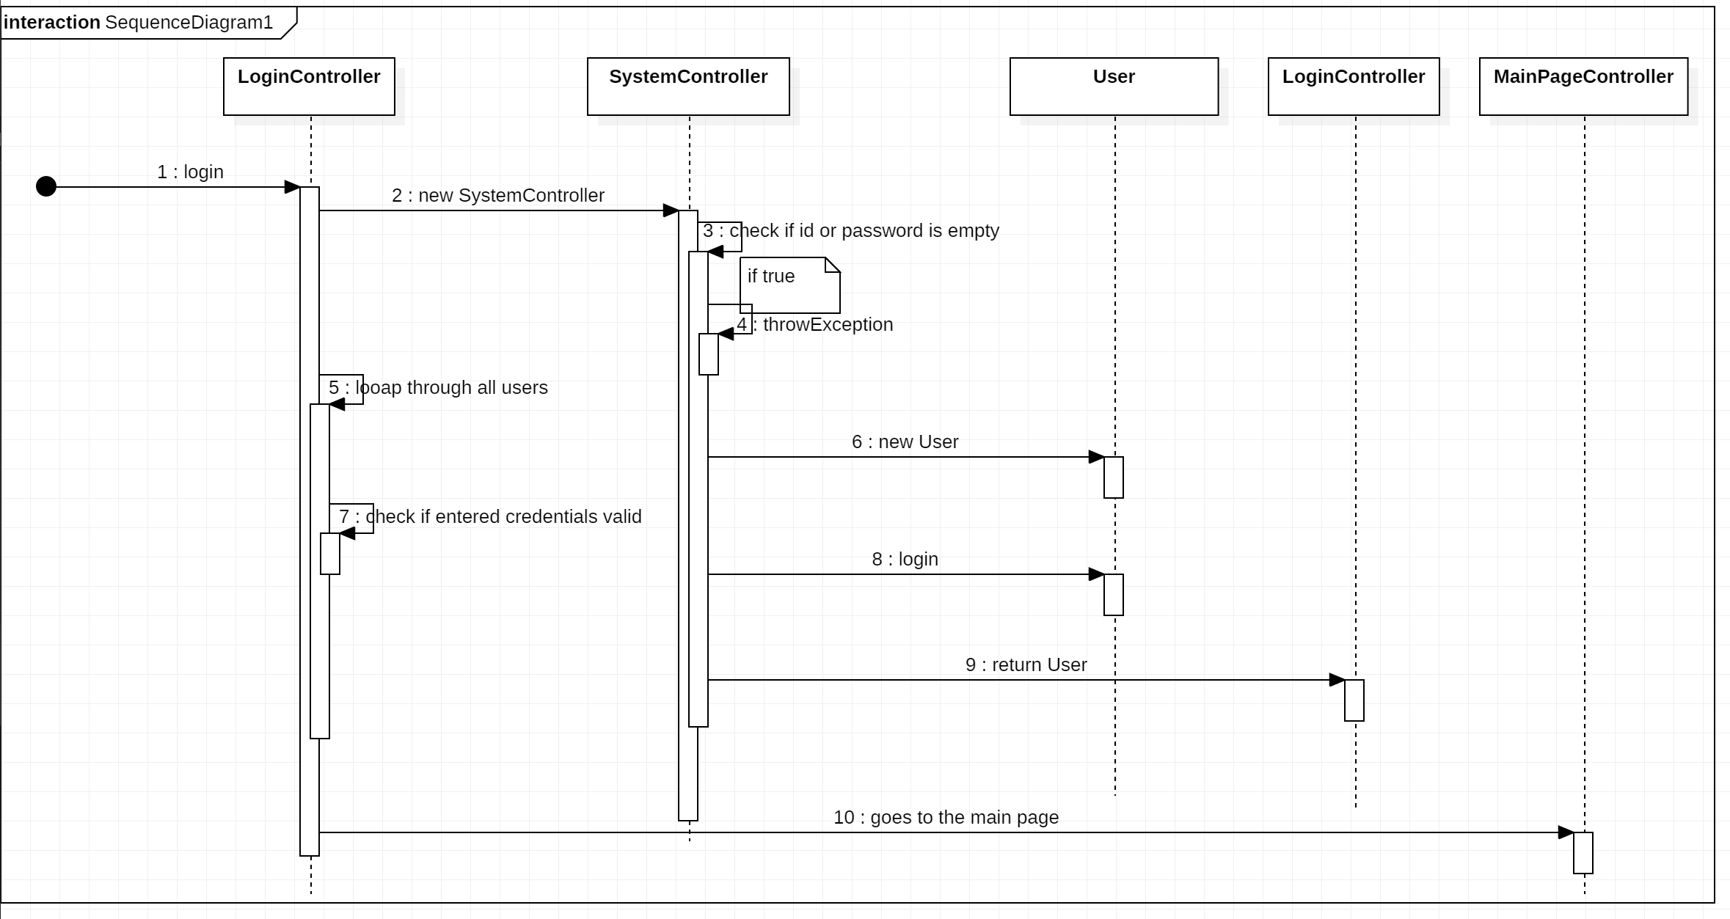
Sequence Diagram (Login)

Slide 5
Login Use Case
Login form used to enter the user’s credentials from the user input.
The LoginController login method creates an instance of SystemController in order to case the login use case method.
The login method check the id and password if not entered, then it shows an error message.
If false, then, it logs the user along with his authorization level.
Finally, the user gets access to the system and get moved to the main page.

Slide 6
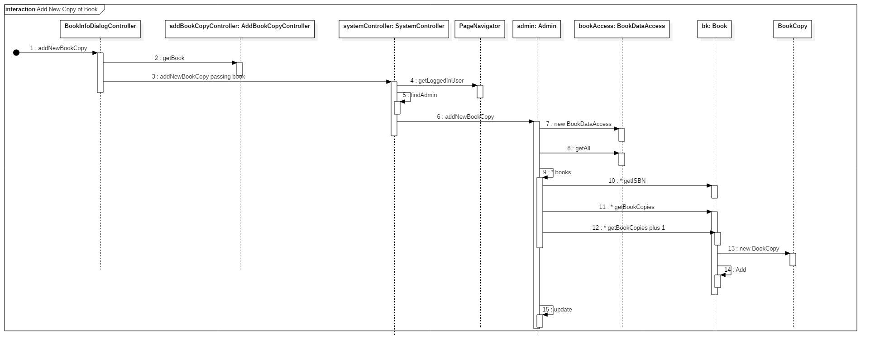
Sequence Diagram (Add Book copy)

Slide 7
Add Book Copy Use Case
The system first asks for isbn for the book to make sure it exists in the library.
Then, it checks if it’s available or not.
Finally, it asks the user to confirm if he wants to make a copy of this book.

Slide 8
Application UI Design
Login Page.
Main layout divided into menu bar and content to display each screen.

Slide 9
SCI Principle
Through transcendental meditation. We have been to reach the deepest level of pure consciousness which allowed us to reach the most level of thinking and creativity to make the project.

